Slide 1

Shaping Tech’s Future: Trends, Diversity, and Skills Evolution
Rodrigo Hurtado Molero
December 12, 2024

Slide 2



OUTLINE
Executive Summary
Introduction
Methodology
Results
Visualization – Charts
Dashboard
Discussion
Findings & Implications
Conclusion
Appendix

Slide 3

EXECUTIVE SUMMARY
The survey data reveals a strong correlation between age and educational attainment, with younger demographics demonstrating higher levels of education. The 25-34 and 18-24 age groups are significantly more likely to hold Bachelor's and Master's degrees. As age increases, the percentage of respondents with higher education decreases, with secondary school education becoming more prevalent in older age groups.
The survey also highlights geographic disparities in respondent distribution. The United States has the highest number of respondents, followed by India, Germany, France, and the United Kingdom.
In terms of programming languages, Python and JavaScript emerge as the most popular and desired languages. PostgreSQL and Microsoft SQL Server are the leading database choices. Microsoft Azure and Amazon Web Services (AWS) are the preferred cloud platforms, and Spring Boot and ASP.NET Core are the most widely used web frameworks.

Slide 4

INTRODUCTION
In this section, we will present the key findings from our comprehensive survey. We'll explore the preferences and trends of developers worldwide, focusing on:
Demographic Insights: Age, location, and educational background of respondents.
Language Landscape: The most popular and desired programming languages.
Database Dynamics: The preferred database solutions.
Platform Preferences: The most commonly used and desired platforms.
Web Framework Trends: The leading web frameworks in the developer community.
Through data-driven analysis, we will identify emerging patterns and highlight actionable insights to help you stay ahead of the curve in the ever-evolving world of technology.

Slide 5

METHODOLOGY
Data Collection
Survey Design: A comprehensive survey was designed to gather information on various aspects of developer preferences and trends, including programming languages, databases, platforms, web frameworks, and demographic information.
Survey Distribution: The survey was distributed through various channels, including online platforms, social media, and developer communities.
Data Collection Period: The survey was open for [specify time period, e.g., two weeks].
Data Cleaning and Preparation
Data Validation: The collected data was thoroughly validated to ensure accuracy and consistency.
Data Cleaning: Any inconsistencies, errors, or missing values were identified and addressed.
Data Preparation: The data was cleaned, formatted, and transformed into a suitable format for analysis.
Data Analysis
Descriptive Analysis: Descriptive statistics were used to summarize the data, including measures of central tendency (mean, median, mode) and dispersion (standard deviation, range).
Frequency Analysis: Frequency distributions were calculated to determine the frequency of occurrence of different categories (e.g., programming languages, databases, platforms, web frameworks).
Cross-Tabulation: Cross-tabulations were used to analyze the relationship between two categorical variables (e.g., age and programming language preference, location and database preference).
Data Visualization: Data visualizations, such as bar charts, pie charts, and scatter plots, were used to present the findings in a clear and concise manner. Designed a dynamic and user-friendly dashboard using Google Looker Studio to present real-time visualizations of key finding
By employing these rigorous methodologies, we have been able to generate reliable and insightful findings that can be used to inform future trends and decision-making in the developer community.

Slide 6
RESULTS
Demographic Analysis
Age Distribution: The majority of respondents were between the ages of 25-34, followed by the 18-24 age group.
Geographic Distribution: The United States had the highest number of respondents, followed by India, Germany, France, and the United Kingdom.
Technology Preferences
Programming Languages:
Python and JavaScript emerged as the most popular and desired languages.
TypeScript and C# also gained significant popularity.
Functional programming languages like Go, Rust, and Kotlin are gaining traction.
Databases:
PostgreSQL and Microsoft SQL Server were the most preferred databases.
MySQL and MongoDB remained popular choices.
NoSQL databases like DynamoDB and Cloud Firestore are gaining momentum
Platforms:
Microsoft Azure and Amazon Web Services (AWS) were the most commonly used and desired platforms.
Google Cloud Platform was also widely adopted.
Serverless platforms like Vercel and Netlify are gaining popularity.

Slide 7
RESULTS CONTINUED
Web Frameworks:
Spring Boot and ASP.NET Core were the most popular web frameworks.
Django and React were also widely used.
FastAPI and Next.js are emerging as strong contenders.
Educational Attainment:
Younger respondents, especially those aged 25-34 and 18-24, were more likely to hold Bachelor's and Master's degrees.
Older respondents were more likely to have secondary school education.
Overall Trends
Cloud-native technologies are becoming increasingly popular.
Low-code/no-code development is gaining traction.
AI and machine learning are being integrated into development workflows.
Remote work and flexible work arrangements are becoming more common.
By understanding these trends, developers and organizations
can make informed decisions to stay ahead of the curve and capitalize on
emerging opportunities

Slide 8
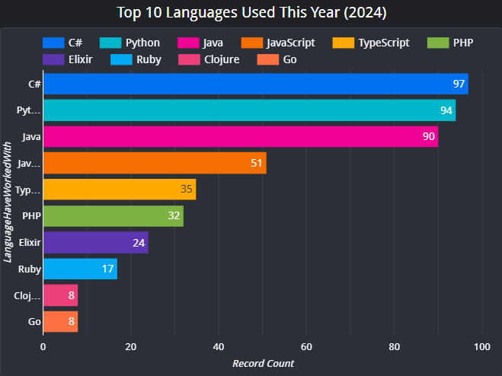
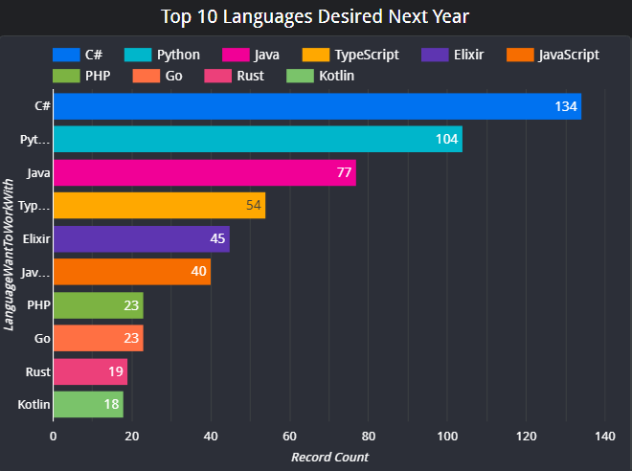
PROGRAMMING LANGUAGE TRENDS
Current year
Next Year

Slide 9
PROGRAMMING LANGUAGE TRENDS - FINDINGS & IMPLICATIONS
Findings
C# and Python Dominance: Both C# and Python hold strong positions in both the “current year" and “next year" categories. This indicates their versatility and wide-ranging applications in various industries.
JavaScript and TypeScript Popularity: JavaScript, the core language of web development, and its typed superset, TypeScript, are highly popular and desired. This reflects the continued growth and importance of web development.
Java's Enduring Relevance: Java, a long-standing language, maintains its relevance, especially in enterprise applications and Android development.
Functional Programming on the Rise: Languages like Elixir, Go, Rust, and Kotlin, which embrace functional programming paradigms, are gaining traction. This suggests a growing interest in building scalable, reliable, and efficient systems.
Shift Towards Modern Languages: There's a clear trend towards modern languages that offer improved productivity, performance, and maintainability. This is evident in the increasing popularity of TypeScript and functional programming languages.
Implications
Skill Development: Developers should consider acquiring skills in C#, Python, JavaScript, and TypeScript to remain competitive in the job market.
Technology Adoption: Organizations should adopt technologies and frameworks that are built on these popular languages to leverage their benefits and attract top talent.
Education and Training: Educational institutions and training providers should update their curricula to include these languages and their associated technologies.
Future Trends: Keep an eye on emerging trends in functional programming and other modern paradigms.
Talent Acquisition: Companies should focus on hiring developers with expertise in these languages to drive innovation and growth.

Slide 10
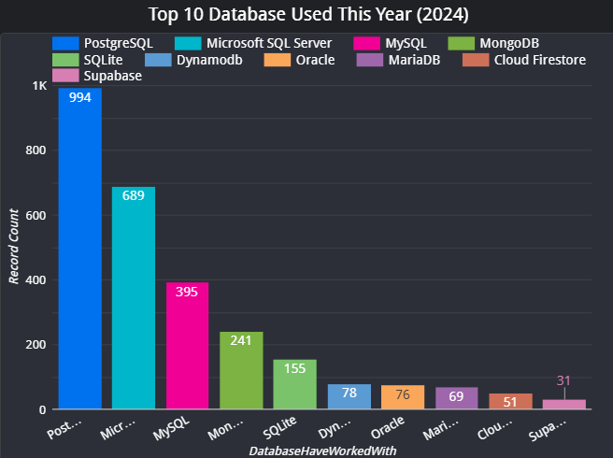
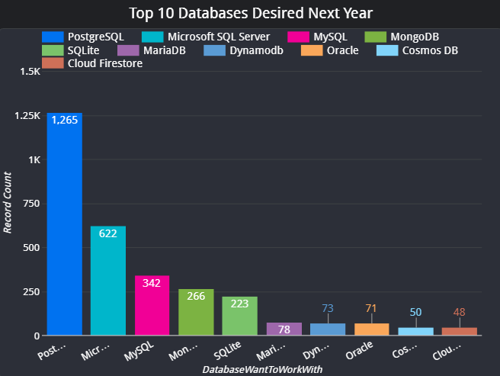
DATABASE TRENDS
Current Year
Next Year

Slide 11
DATABASE TRENDS - FINDINGS & IMPLICATIONS
Findings
PostgreSQL Dominance: PostgreSQL is the most widely used database and the most desired for the next year. This indicates its popularity and versatility in various applications.
Microsoft SQL Server and MySQL Popularity: Both Microsoft SQL Server and MySQL are popular choices, especially in enterprise environments and web development.
NoSQL Databases Gaining Traction: NoSQL databases like MongoDB, DynamoDB, and Cloud Firestore are gaining popularity, particularly for handling large volumes of unstructured data and real-time applications.
SQLite's Niche Use: While SQLite is widely used for embedded systems and mobile applications, it's not as popular for larger-scale applications.
Emerging Databases: Databases like Supabase and MariaDB are gaining traction, offering unique features and benefits.
Implications
Skill Development: Developers should consider acquiring skills in PostgreSQL, Microsoft SQL Server, MySQL, and NoSQL databases to meet the demands of the market.
Technology Adoption: Organizations should carefully evaluate their database needs and choose the right database technology based on their specific requirements.
Data Management: Effective data management practices are crucial to handle the increasing volume and complexity of data.
Cloud-Native Databases: Cloud-native databases like DynamoDB and Cloud Firestore are becoming increasingly popular for their scalability and ease of use.
Open-Source vs. Proprietary: The choice between open-source and proprietary databases depends on factors such as cost, licensing, and support.

Slide 12

DASHBOARD
https://lookerstudio.google.com/s/nEQQiBtD4aY

Slide 13
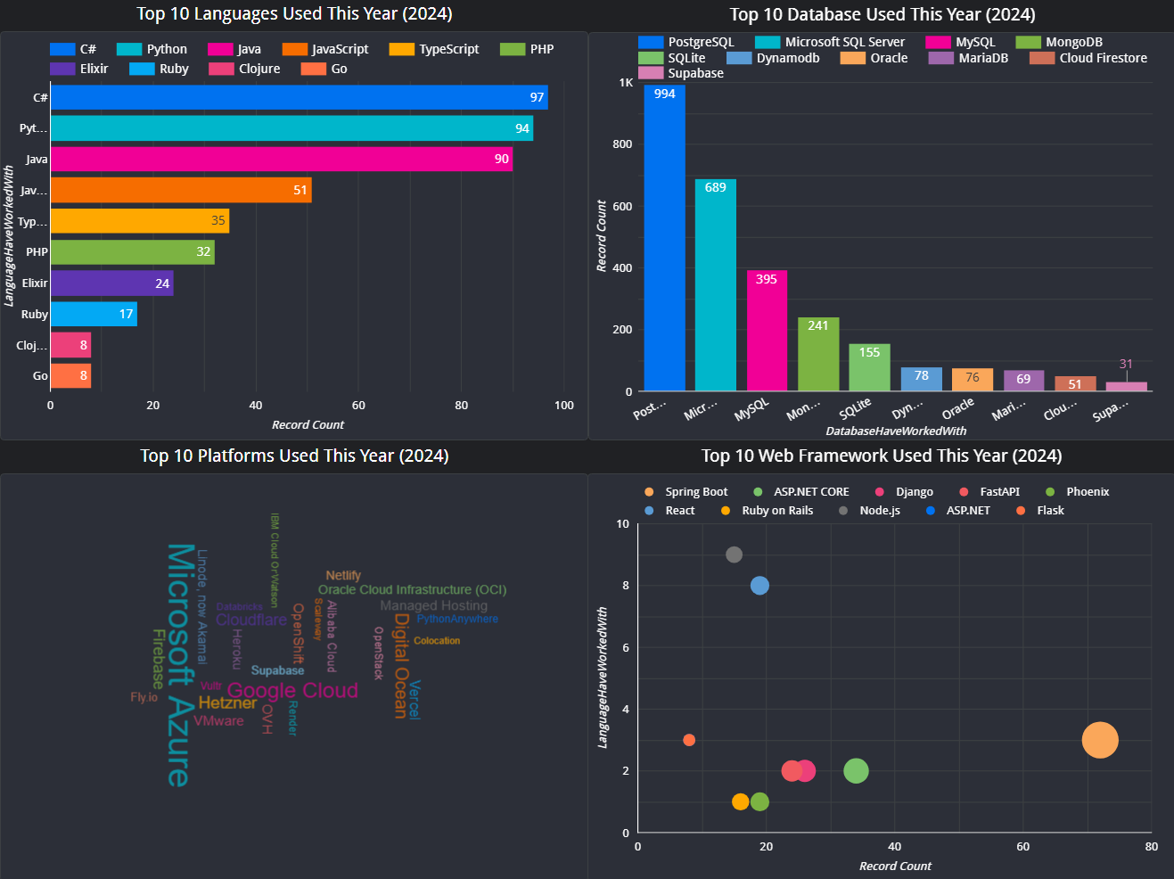
DASHBOARD TAB 1

Slide 14
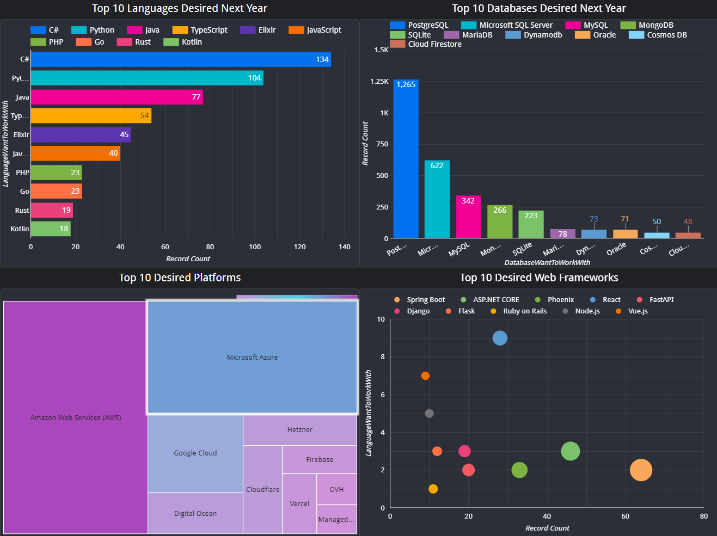
DASHBOARD TAB 2

Slide 15
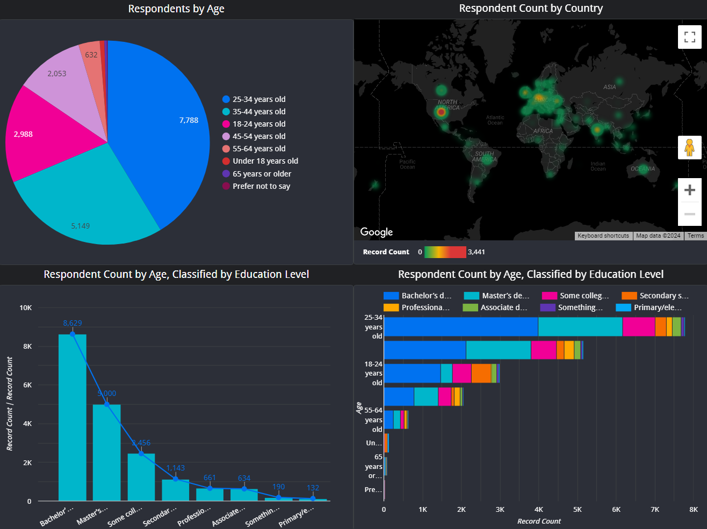
DASHBOARD TAB 3

Slide 16
DISCUSSION
Programming Languages and Frameworks
Python and JavaScript remain dominant, with strong growth expected.
TypeScript continues to gain popularity for large-scale JavaScript projects.
Functional programming languages like Elixir, Go, and Rust are gaining traction, particularly for building scalable and reliable systems.
Cloud-native frameworks and tools are becoming increasingly important.
Databases
PostgreSQL is the most popular and desired database, offering a strong feature set and a large community.
NoSQL databases like MongoDB and DynamoDB are gaining traction, especially for handling large volumes of unstructured data and real-time applications.
Cloud-native databases are becoming more prevalent, leveraging the benefits of cloud platforms.
Platforms and Infrastructure
Cloud platforms like Azure, AWS, and Google Cloud are essential for modern application development.
Serverless computing and containerization are simplifying deployment and scaling.
Infrastructure as Code (IaC) tools like Terraform and Pulumi are gaining popularity for automating infrastructure provisioning.

Slide 17
DISCUSSION CONTINUE
Overall Trends
Developer Experience: Tools and frameworks that improve developer productivity and experience are in high demand.
Cloud-Native Development: Cloud-native architectures and technologies are becoming the norm.
AI and Machine Learning: The integration of AI and ML into applications is increasing.
Data Science and Big Data: The demand for data scientists and big data engineers continues to grow.
Implications for Developers and Organizations
Continuous Learning: Developers should stay updated with the latest trends and technologies.
Cloud-Native Skills: Proficiency in cloud platforms and cloud-native technologies is essential.
Data Science and AI: Acquiring skills in data science and machine learning can be beneficial.
Security and Privacy: Prioritizing security and privacy is crucial in today's digital landscape.

Slide 18
OVERALL FINDINGS & IMPLICATIONS
Findings
Python and JavaScript remain dominant programming languages, especially for web development and data science.
TypeScript is gaining popularity for large-scale JavaScript applications.
Functional programming languages like Elixir, Go, and Rust are emerging for building scalable and reliable systems.
Cloud-native technologies are becoming increasingly important, with platforms like Azure, AWS, and Google Cloud leading the way.
Serverless computing and containerization are simplifying application deployment and management.
NoSQL databases are growing in popularity for handling large volumes of unstructured data.
Data science and machine learning are driving innovation across various industries.
Implications
Continuous Learning: Developers should stay updated with the latest trends and technologies to remain competitive.
Cloud-Native Skills: Proficiency in cloud platforms and cloud-native technologies is essential for modern application development.
Data Science and AI: Acquiring skills in data science and machine learning can open up new opportunities.
Security and Privacy: Prioritizing security and privacy is crucial to protect sensitive data and systems.
Remote Work and Collaboration: Organizations should invest in tools and strategies to support remote work and collaboration.
Talent Acquisition and Retention: Companies should focus on attracting and retaining top talent by offering competitive compensation, flexible work arrangements, and opportunities for professional development.

Slide 19

CONCLUSION
To summarize, the survey data reveals several key trends shaping the developer landscape:
Dominance of Python and JavaScript: These languages continue to be the most popular choices, particularly for web development and data science.
Rise of Functional Programming: Functional languages like Elixir, Go, and Rust are gaining traction, offering benefits like scalability and reliability.
Cloud-Native Development: Cloud platforms like Azure, AWS, and Google Cloud are driving innovation, with serverless computing and containerization becoming increasingly important.
Data Science and Machine Learning: The demand for data scientists and machine learning engineers is growing, and these fields are becoming more integrated into software development.
Security and Privacy: As cyber threats continue to evolve, developers must prioritize security best practices.
Looking ahead, it is essential to stay updated with the latest trends and technologies. Continuous learning and upskilling are crucial for developers to remain competitive. Organizations should invest in cloud-native technologies, data science, and AI to drive innovation and business growth.

